Slide 2
Review

Slide 3
IOTA Ecosystem - Backbone for IOT
Ecosystem aiming to become the backbone for the “Internet of Things”
Development and promotion by german IOTA Foundation
Based on a “Public Permissionless* Distributed Ledger” (the Tangle)
Specially designed for the IOT and Machine-to-Machine Communication
Feeless transactions (enables microtransactions)
Provides data and value transaction capability
High scalability
Quantum Proof (due to Winternitz one-time-signature scheme**)
* definition public permissionless, see slide „Open Ecosystems vs. Private Solutions“ ** https://eprint.iacr.org/2011/191.pdf

Slide 4



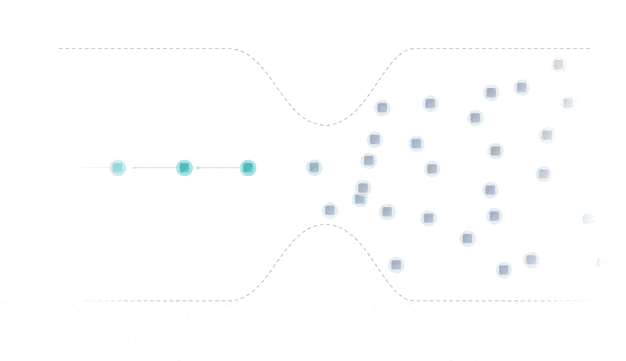
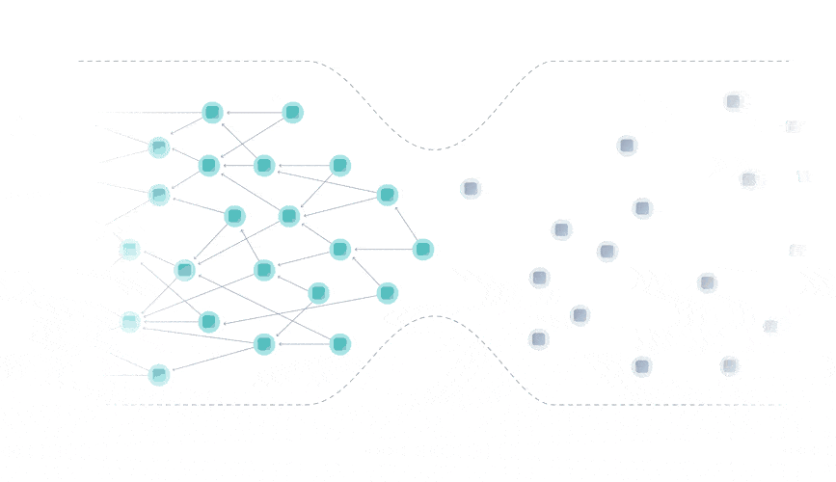
Future Proof Data Architecture
Blockchain
Tangle
(DAG - Directed Acyclic Graph)
Blockchain bottleneck
Tangle scales with transaction volume
* https://docs.iota.org/docs/getting-started/0.1/network/the-tangle

Slide 5
Global standard for IOT-Applications
“Our vision is to make the machine economy a reality. The big problem with the Internet of Things is that machines often speak different languages ​​because the protocols are not compatible. IOTA is to become the protocol of the machine economy. You can not only send money via the Tangle, but also data. For example, from a sensor, or even smart contracts like Ethereum.”
Dominik Schiener, Co- Founder IOTA Foundation
"IOTA is the obvious solution and standardization will make it stronger.“
“"There will be an IOTA standard from the OMG and eventually from the International Organization of Standards / ISO at the end of next year.“(2020)
Dr. Richard Mark Soley
CEO Object Management Group
CEO Industrial Internet Consortium
IOTA Supervisory Board Member

Slide 6

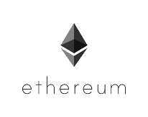





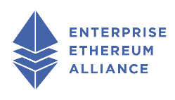



Open Ecosystems vs. Private Solutions
Permissionless
Permissioned
Public - Permissionless DLT: Bitcoin – anyone can join the network, any node in the network can participate in the consensus algorithm (could validate transactions).
Public - Permissioned DLT: Ripple or any POS Blockchain – anyone can join the network, only selected nodes that respect a rule are allowed to validate transactions (to be part of consensus algorithm).
Private - Permissionless DLT: Private Ethereum –"privacy" is ensured by allowing members to join the network if they have VPN credentials and/or digital certificates. Any node can participate in consensus algorithm.
Private - Permissioned DLT: Hyperledger Fabric, Corda - "privacy" is ensured by allowing members to join the network if they have access rights. The permission to validate transactions (in the consensus algorithm) is granted to certain predefined nodes.
Everyone can be a network maintainer*
Closed group of network maintainers*
Public
Data access for everyone
Open Ecosystems
Private Solutions
Private
Data access limited to predefined users
(in permissionless mode)
* Have a copy of the ledger and validate transactions
** Few public DLTs support encrypted Datastreams to provide privacy within open ecosystems (similar to an encrypted email)

Slide 7
More than just a protocol
Environment
Technology
Ecosystem
Acceptance
Architecture*
Blockchain
DAG (IOTA)
Hashgraph
Consensus* (PoW, PoS, DPoS, PoA)
Capabilities* (incl. second layer implementations and modules)
Partners & Supporters
Data & Industry Marketplace
Development Funds
Community
Consumers (Companys/Officials/Private Consumers)
Value (Use Cases, Usability & Impacts)
Regulatory
Security
Smart Contracts
Economic clustering / sharding
Interoperatibility
Quorum based computing
Distributed Computation
Encrypted Data Channels
* examples
A DLT can only succeed if not only the technology is considered alone, but is created in interaction with an active ecosystem and taking into account the acceptance in society, politics and consumers!

Slide 8












More than 640 unique entities with a known interest in IOTA
117 official partnerships/collaborators
171 entities engaged in joint projects with the IOTA Foundation
81 known IOTA Data Marketplace participants
92 entities that developed one or more IOTA-based proof-of-concepts
324 academic references from 196 academic institutions
http://iotaarchive.com/listing.html

Slide 9
Enabling Industrie 4.0 & Machine Economy

Slide 10
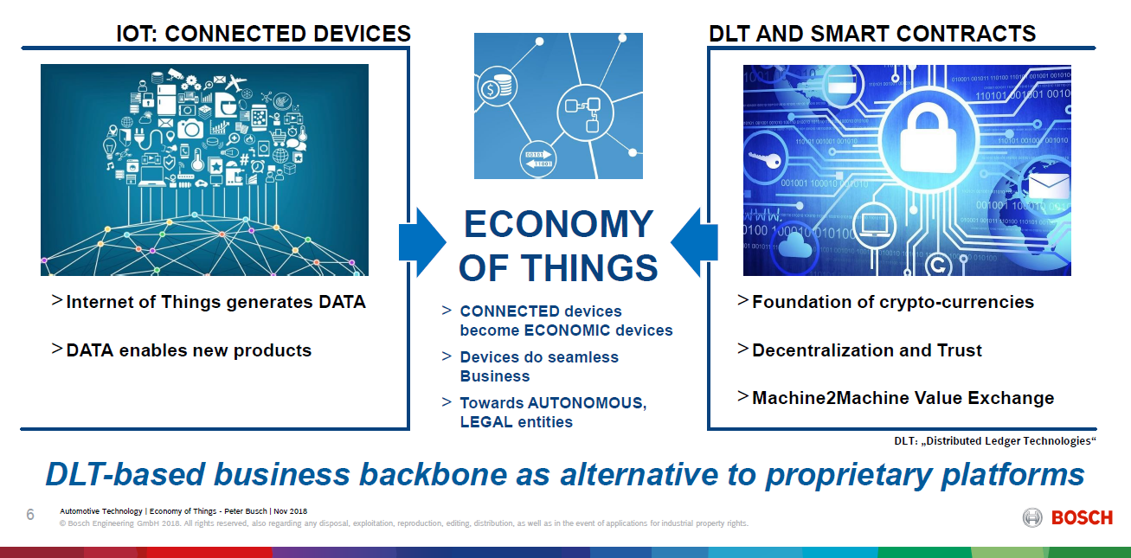
DLT enables „Next Generation of the IoT“

Slide 11
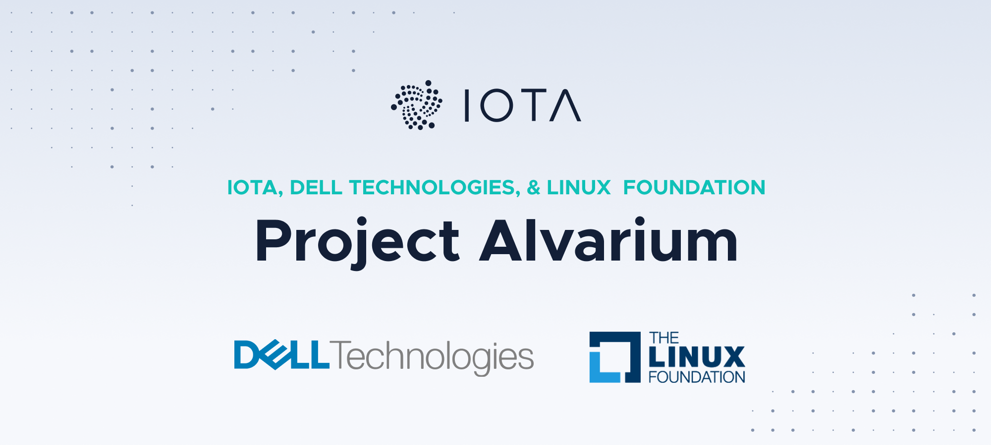
Project Alvarium
https://alvarium.org/

Slide 12




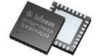

Project Alvarium
Project Mission
Create framework and open APIs and bind together existing trust insertion technologies
Develop confidence score algorithms
Data Confidence Fabrics
Collection of trust insertion technologies delivering data to applications with measurable confidence
Scale trust across heterogeneous systems
“Perfect 10”
Ledger Registration
+2
High Trust
Secure Immutable Storage
+2
Provenance
Metadata
+2
Medium
Trust
Gateway Authorization/Authentication
+2
Device Signatures
+2
Low
Trust
0
Unknown
Trust
(No DCF)

Slide 13
Project Alvarium
Example trust insertion technologies
TPM
ARM PSA-RoT), TrustZone
Linaro Trusted Substrate
Intel/Arm SDO
VMware Lightwave
Keycloak
EdgeX Foundry
Fledge
Eclipse Kura
Intel SGX
Microsoft Open Enclave SDK
Red Hat Enarx
Siemens Coaty.io
Tibco Flogo
CNCF Open Policy Engine
IPFS
Hyperledger
IOTA
1. HW root of trust signatures on device data
2. Gateway Authorization/Authentication
3. Open data ingestion software
4. Trusted Execution Environments
5. Metadata/ policy attachment
(e.g. data capture environment, provenance, confidence score, policies for sharing/monetization)
6. Secure, immutable scale-out storage
7. Registration of trusted assets in a multi-cloud distributed ledger

Slide 14
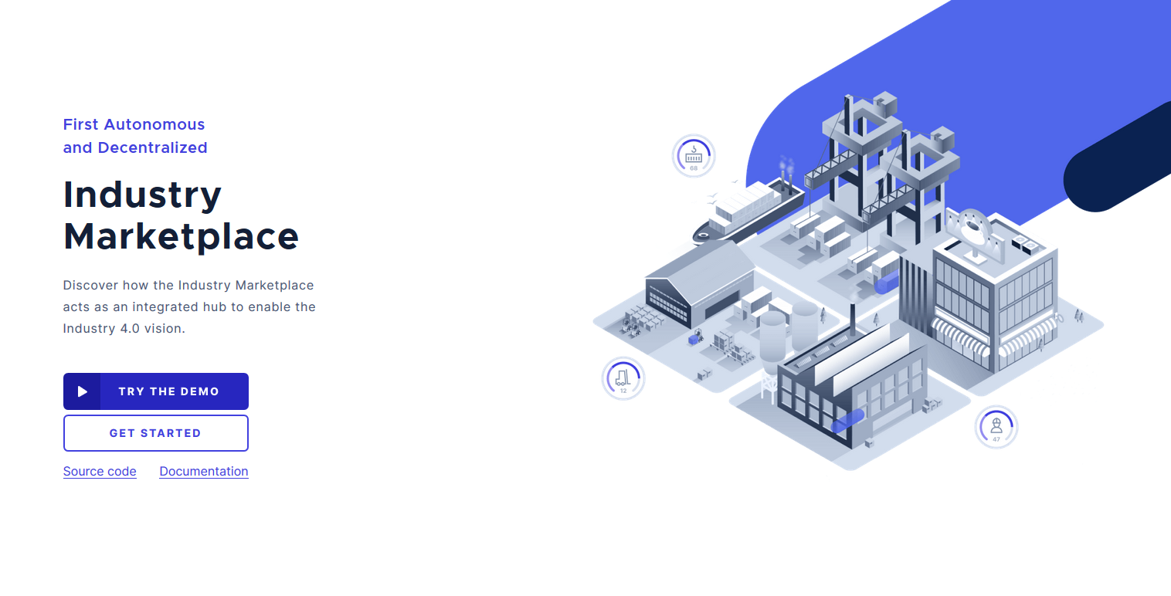

https://industrymarketplace.net//
https://docs.iota.org/docs/blueprints/0.1/data-marketplace/overview

Slide 15
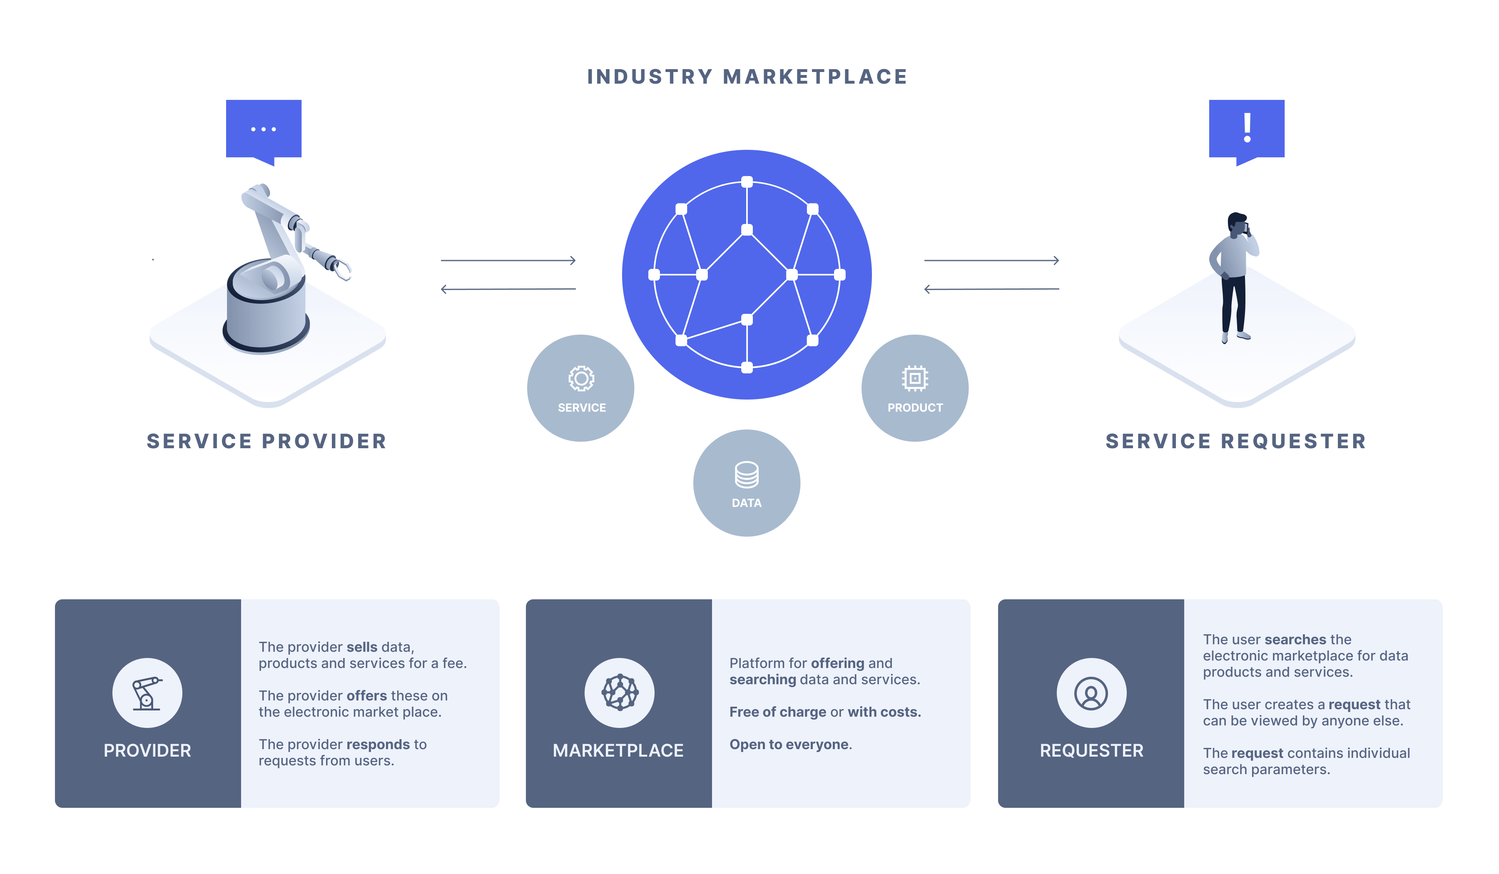
IOTA Industry Marketplace

Slide 16
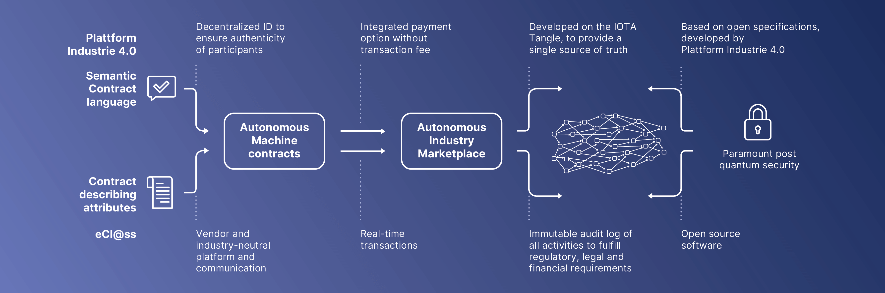
IOTA Industry Marketplace
Specifications by „Plattform Industrie 4.0“ (official central german network to develop and promote industry 4.0)
ISO/IEC compliant data standard (eCl@ss)
Standardized asset representation (AAS)

Slide 17
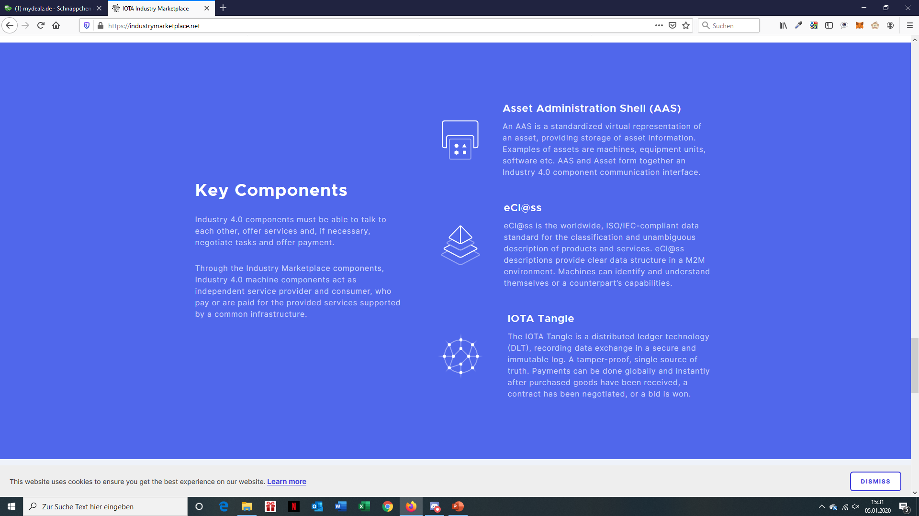
IOTA Industry Marketplace

Slide 18
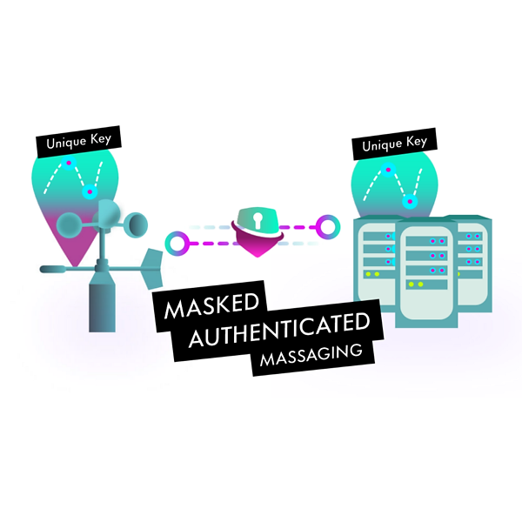
https://docs.iota.org/docs/client-libraries/0.1/mam/introduction/overview

Slide 19
Masked Authenticated Messaging (MAM)
Second layer protocol enabling private and secure data transfer
Application
Trinary/binary, JSON
Service Layer
Data Format
Application Layer
Transport Layer
Connectivity Layer
MAM, MQTT
IOTA
Wifi, LoRA, Bluetooth
Notes:
RUST: https://github.com/iotaledger/MAM Javascript: https://github.com/iotaledger/mam.client.js

Slide 20





Masked Authenticated Messaging (MAM)
Post single data or message streams to a channel
Viewers can subscribe to message stream channels where data can be (continuously) published
“Channel splitting” enables offshoot channels for specific subsets of data accessible for permitted subscribers
Channel Modes
Public: Everyone can view
Restricted: Specify viewers by telling them a key
Private: Only owner can view
Subscriber
Private
Channel Split
Restricted
Public
Message Stream
Notes:
RUST: https://github.com/iotaledger/MAM Javascript: https://github.com/iotaledger/mam.client.js

Slide 21
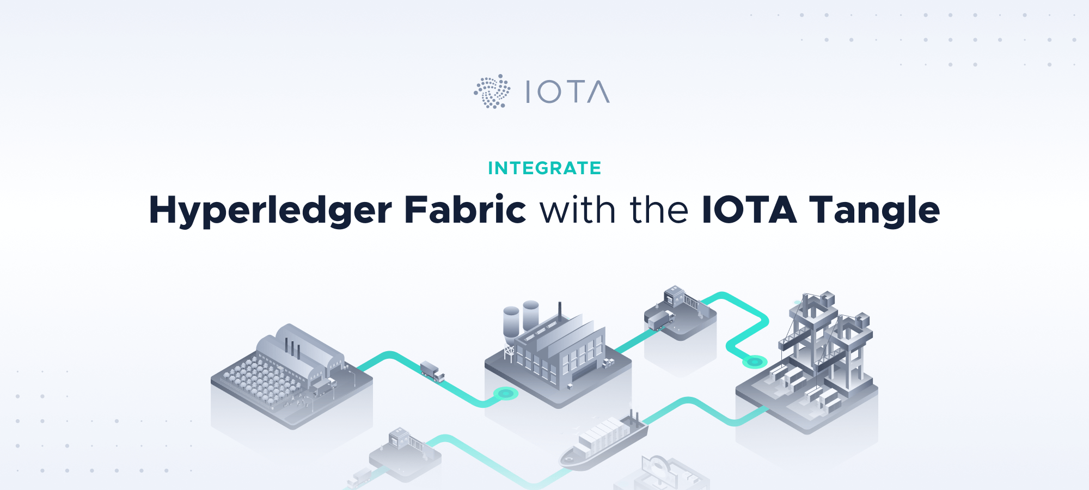
https://blog.iota.org/integrate-hyperledger-fabric-with-the-iota-tangle-9bc3ac873e82

Slide 22
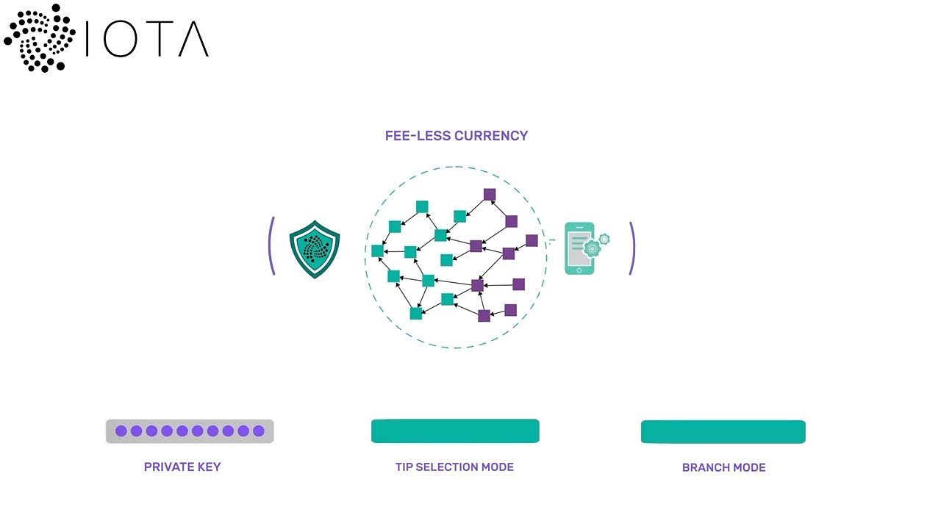



Hyperledger connector
Connect Hyperledger Fabric with IOTA Tangle
Seamless exchange of data via MAM (masked authenticated messaging) streams
Secure and immutable data hub between siloed private/permissioned systems
Private/Permissioned Ledger A
MAM
Public Tangle
MAM
Private/Permissioned Ledger B
Private/Permissioned Ledger A
MAM
Public Tangle
MAM
Private/Permissioned Ledger B

Slide 23
Project Overview
Project Alvarium
MAM (Masked Authenticated Messaging)
Industry Marketplace
Hyperledger Connector
Description
Framework for data confidence fabrics delivering data to applications with measurable confidence.
Description
Emit and access a forward-secret and encrypted data stream over the Tangle.
Description
Decentralized, public and permissionless hub enabling open markets for industry 4.0.
Description
Hyperledger Fabric bridge to securely connect private Hyperledger networks with IOTA Tangle.
Development
Dell, Linux Foundation, IOTA Foundation, (IBM)
Development
IOTA Foundation
Development
IOTA Foundation, eCl@ss, Plattform Industrie 4.0, Otto von Guericke University Magdeburg, Helmut Schmidt University Hamburg, Neoception
Development
IOTA Foundation, Linux Foundation
Status
Prototype released
Status
V1.0 released V1.1. in development (new libraries & features)
Status
Prototype available on public testnet
Status
Released

Slide 24





Next generation Industry 4.0
Project Alvarium
+
MAM (Masked Authenticated Messaging)
+
+
=
Industry Marketplace
+
Hyperledger Connector
Autonomous Global Industry Network

Slide 25
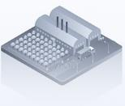




Machine economy
Industry 4.0 leads to global machine economy
Machines are providers and consumers of services and goods/products
Lifecycle of goods and services as well as payments will be executed, recorded and traced on the distributed ledger (here Tangle)
Machines are autonomous market participants and e.g. choose their suppliers depending on current market prices, availability, quality, time for delivery etc.

Slide 26
If machines have an own economy …
… what is the impact on banking industry? Note: The IOTA Foundation is currently in contact with several large financial institutions (mainly in germany) to co-create interfaces to the „IOTA Tangle Network“ as well as develop business models and use cases for the financial industry.

